Slide 1
Today I will present a simple analysis of a housing price dataset.
Housing Price Analysis
SHANG MA

Slide 2
1
Problem Background
Housing prices are increasing rapidly
Buyers need accurate price estimation
We want to understand:
What factors affect house prices?
In real life, house prices are affected by many factors.
In this project, we try to understand what influences house prices.

Slide 3
2
Dataset Overview
Source: Kaggle
Features:
Area
Bedrooms
Bathrooms
Location
This dataset contains information about houses.
Each row represents one house with features like area and bedrooms.

Slide 4
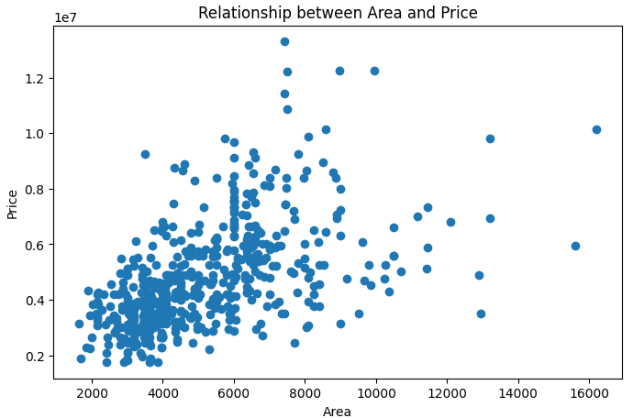
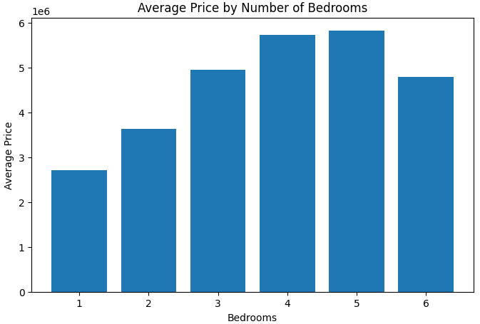
3
Key Findings
Larger area → higher price
More bedrooms → higher price
Preferred area houses are more expensive
From the analysis, we can see that area has a strong relationship with price.
Houses with larger area tend to have higher prices.
Also, houses in preferred areas are more expensive.

Slide 5
4
Conclusion
House price depends on multiple factors
Area and location are key factors
This data can help predict house prices
In conclusion, house prices are not random.
They are influenced by factors like area and location.
This dataset can be used for price prediction.
This is a regression problem because we are predicting a continuous value.

Slide 6
Thank You

